Slide 1

Web scraping to gain company insights
- Sejal

Slide 2
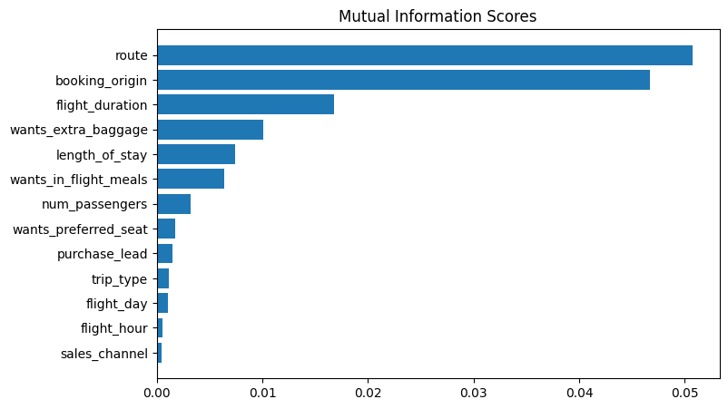
The predictive model to understand factors that influence buying behavior
We have trained the data set with Random forest classifier model and received
ACCURACY: 85.09
AUC score: 0.558
route
booking_origin
flight_duration
wants_extra_baggage
length_of_stay
Are the top 5 features that influence
Customer buying behavior
We need to increase the AUC score.

